Slide 1
Accounting for Adjustments (Part 2)
FNDb020
LECTURE 05
Completing the Accounting Cycle

Slide 2
Learning OBJECTIVES
Adjusting Entries (Part 2)
Completing the Accounting Cycle

Slide 3
The Accounting Cycle
1. Recognise and record transactions
Refer to all source documents
2. Journalise transactions
In the General Journal
3. Post to ledger accounts
In the General Ledger
4 Trial Balance - Unadjusted
4. Prepare Trial Balance
Trial Balance
5. Prepare the Financial Statements
Financial Statements
Notes:
SLIDE BUILD
Show students that they are up to the fourth step in the accounts preparation. Remind them the first 3 weeks we learnt how to analyse a business transaction, how to record the transaction in the journal and then last week how to post transactions to the general ledger.
Click: trial Balance - unadjusted

Slide 4
Accounting for Adjustments
4 Trial Balance -Unadjusted
4a. Prepare unadjusted Trial Balance of General Ledger
Trial Balance (unadjusted)
4b. Determine adjusting entries and/or
4c.Post adjusting entries to General Ledger
General Ledger (accounts adjusted)
4d. Prepare adjusted Trial Balance of General Ledger
Trial Balance (adjusted)
5. Prepare the Financial Statements

Slide 5
Accounting for Adjustments: Why are adjustments necessary
Financial Statements communicate information to external users.
Any accounts that should be adjusted but are unadjusted will cause an error to the Financial Statement reporting.
This could lead to poor decision making and can cause financial problems.

Slide 6
Adjustments are done only on Balance Date
Adjusting entries are recorded to the Accounting Systems on Balance Date i.e.last day of the reporting period
A separate general journal entry is made.
Correcting over the original entry is not allowed. This will be considered as deliberately hiding a wrong doing. The “MYOB” accounting software does not allow erasing of entries.

Slide 7
3 Prepaid Expenses
Asset is overstated, Expenses understated, Equity overstated;
After Adjustment:
Expense is recognised, Asset is reduced
Task
Prepaid Insurance $1200 for 1-year purchased on 1st Jan (recorded as an Asset with 12 months of future economic benefit) has been used up over Jan, Feb, Mar, Apr, May Jun and must now be expensed on balance date 30 Jun 2018
Dr | Prepaid Insurance (asset) |  | Cr
1/1 | bank 1200

Slide 8
4. Prepaid Revenue
:
Liability overstated, Revenue understated, Equity understated
After Adjustment:
Expense is recognised, Asset is reduced
Task
Received cash payment in advance for a promise to provide services in the future (liability until services is provided). Example: Adele was paid $6,000 in April to provide design services for the 3 months covering Apr, May & June. In Apr the journal entry was:
Dr Cash at Bank (A+) $6,000
Cr Unearned Revenue (L+) $6,000
What is the adjustment entry at 30/6?

Slide 9
Prepaid Revenue

Slide 10
6 Accrued Expenses:
Expenses & Liability understated, Equity overstated
After Adjustment:
Expense is recognised, Liability is reduced
Task
Adele has not recorded that she owes (liabilities) $600 wages to her part-time assistant for helping out in the business in the current accounting period (expenses).

Slide 11
7 Accrued Revenue:
Asset & Income understated, Equity understated
After Adjustment:
Asset is recognised, Income increases
Task
The Nursery owes Adele (accounts receivable) Commission of 5% of sales revenue (income) to Adele for introducing a client. Worth $550

Slide 12
9 From unadjusted Trial Balance to Accounting Reports see Review Task 1

Slide 13
11 Review Balance Day Adjustments

Slide 14
14 THE closing process
The Closing Process is done at the end of the accounting year & once each year
It involves ‘closing’ of Income and Expense accounts to a temporary Profit or Loss Summary account to determine net profit(loss)

Slide 15
14 Why do we close off accounts?

Slide 17
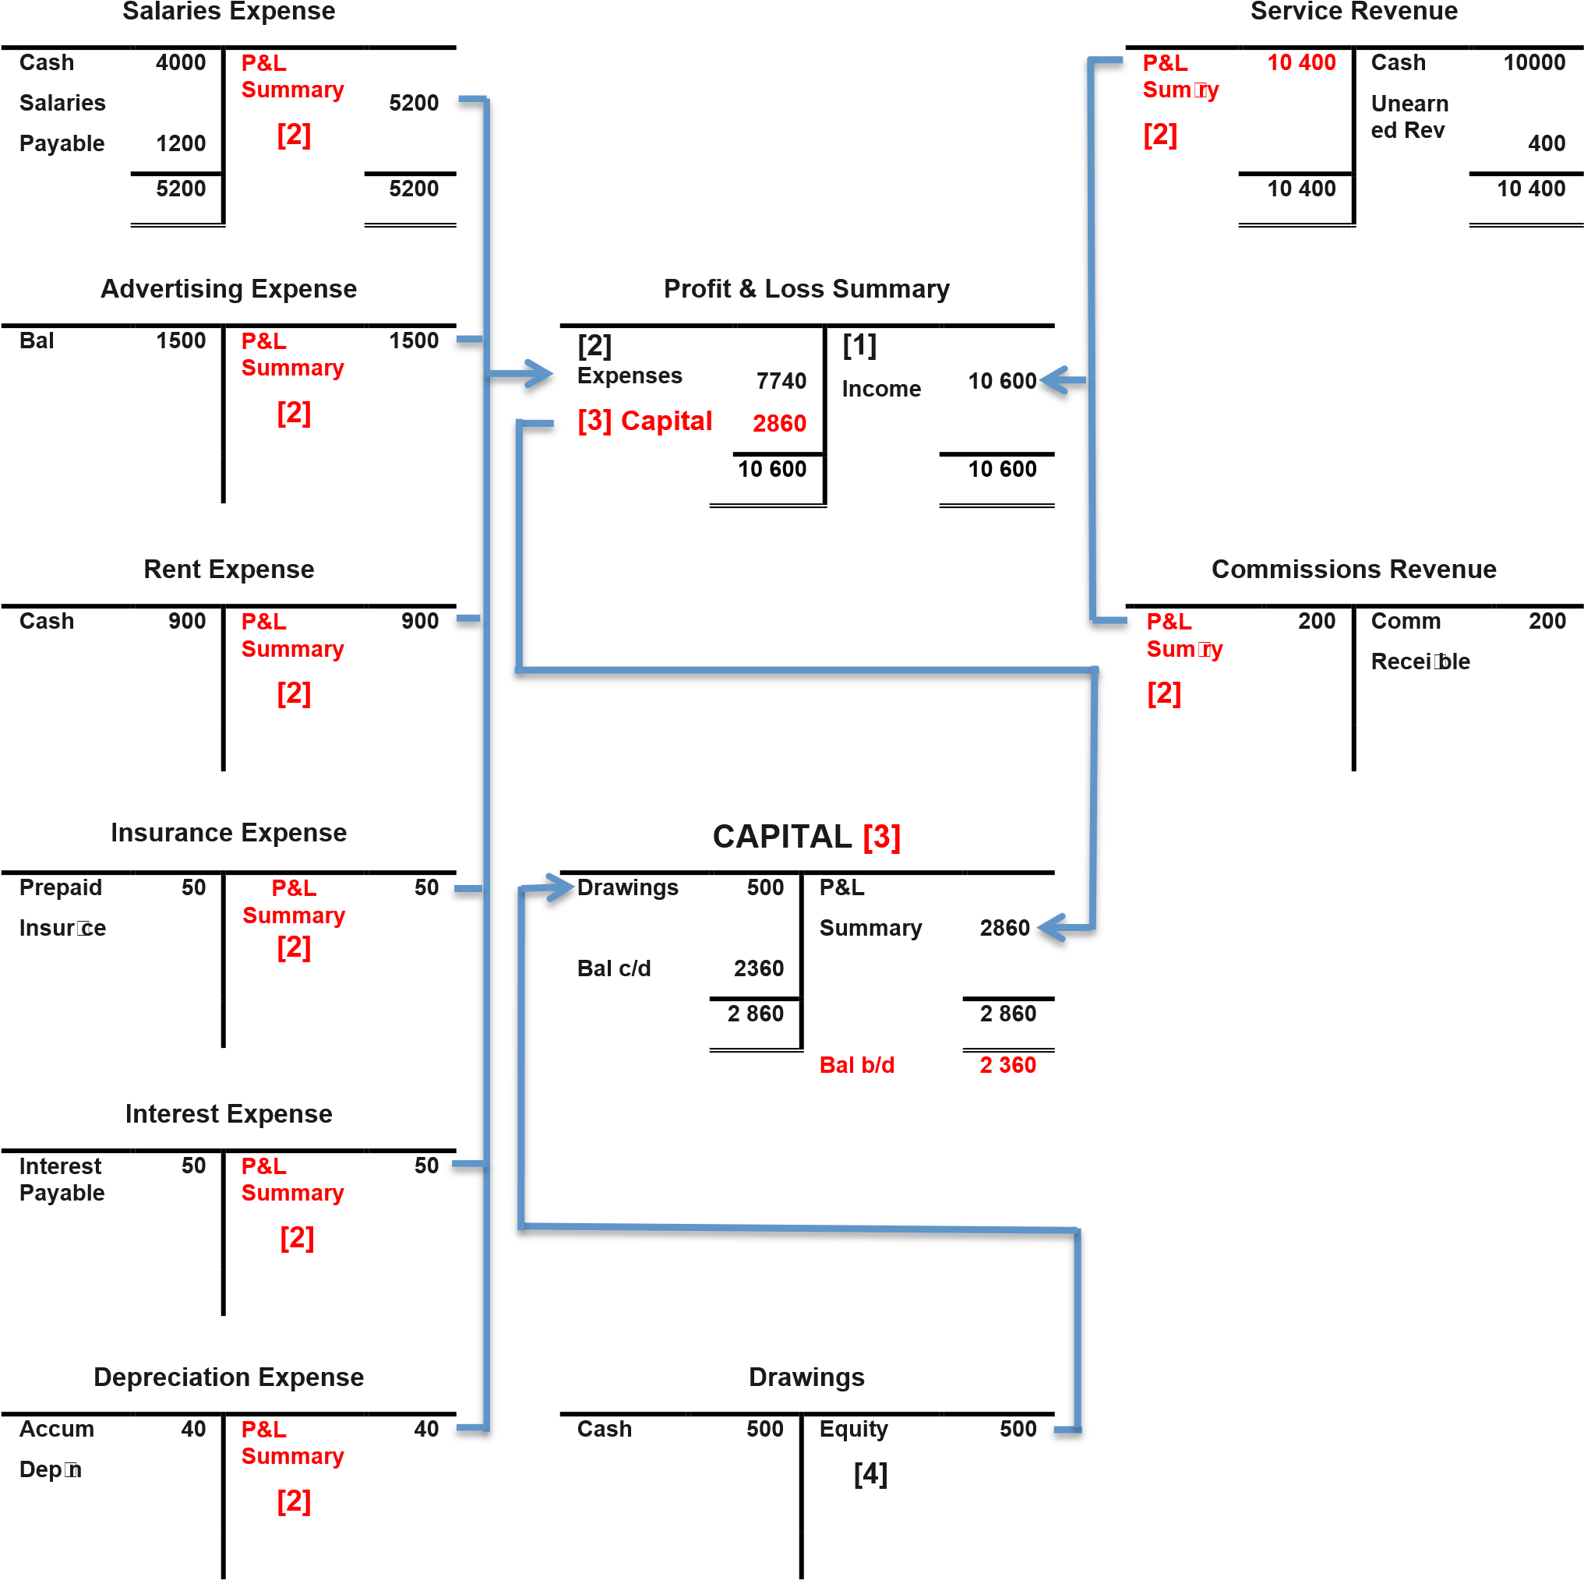
16 Summary

Slide 18
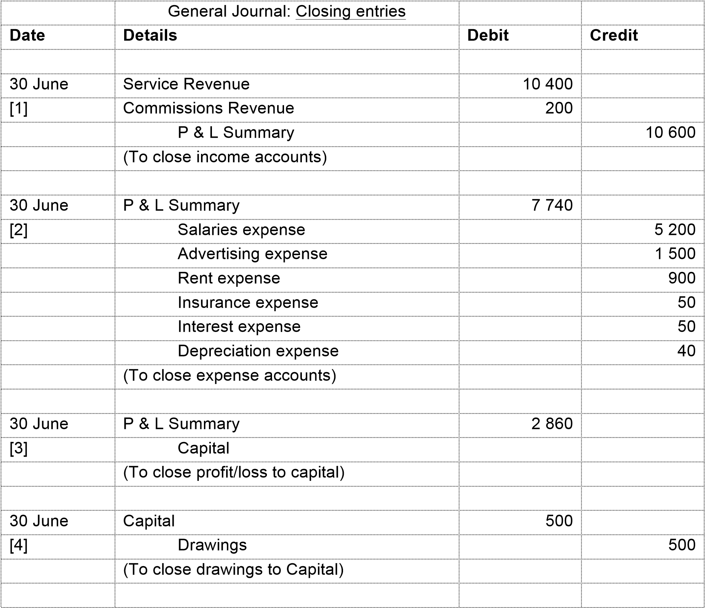

Slide 19
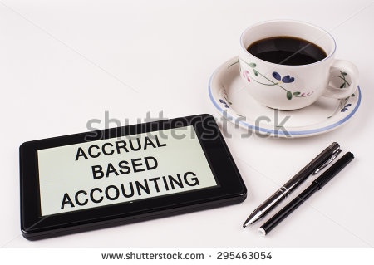
19 CLOSING ENTRIES & Post-Closing Trial Balance
NANDINI’S SPA
(WORKBOOK 19)

Slide 20
Tutorial week 5
Questions 4.3, 4.5, 4.15

